Slide 1
Ventricular Tachycardia in the absence of structural heart disease.
Dr. Kailash Kumar Goyal

Slide 2
Constitutes for 10% of patients presenting with ventricular tachycardia.
Two types:-
1. Non life threatening – typically monomorphic
2. Life threatening - typically polymorphic.
Ventricular arrhythmias in the absence of structural heart disease. Eric N. Prystowsky, MD. Vol. 59, no. 20, 2012 ISSN0735-1097 JACC

Slide 3
Classification
Non Life threatening- typically monomorphic
A. Outflow tract
- Right ventricular outflow
- Left ventricular outflow
- Aortic sinus of valsalva
B. Idiopathic left ventricular tachycardia
- Left posterior fascicle
- Left anterior fascicle
- High septal fascicle
C. Others
- Mitral annulus
- Tricuspid annulus
- Papillary muscle
Ventricular arrhythmias in the absence of structural heart disease. Eric N. Prystowsky, MD. Vol. 59, no. 20, 2012 ISSN0735-1097 JACC

Slide 4
2. Life threatening.
A. Genetic syndromes.
-Long QT syndrome
-Brugada Syndrome
-Catecholaminergic polymorphic ventricular tachycardia
-Short QT
B. Idiopathic Ventricular fibrillation.
Ventricular arrhythmias in the absence of structural heart disease. Eric N. Prystowsky, MD. Vol. 59, no. 20, 2012 ISSN0735-1097 JACC

Slide 5
Outflow tract VT
Most common type of idiopathic ventricular tacycardias.
- 70% originate from RVOT .
- 20% from the aortic cusps.
- 10% from the LVOT, pulmonary artery or the LV epicardium .
Sensitive to Adenosine.
Catheter ablation of cardiac arrythmmias, 3rd edition. Shoei K. Stephen Huang.

Slide 6
Phenotypes
Exhibits three type of phenotypes:-
- Repititive monomorphic PVCs.
- Nonsustained repititive monomorphic VT.
- Paroxysmal exercise induced sustained VT.
Considerable overlap may occur among the three phenotypes.
Ablating one phenotype at a discrete site eliminates the other two phenotypes suggesting all three are representative of the same focal cellular process.

Slide 7
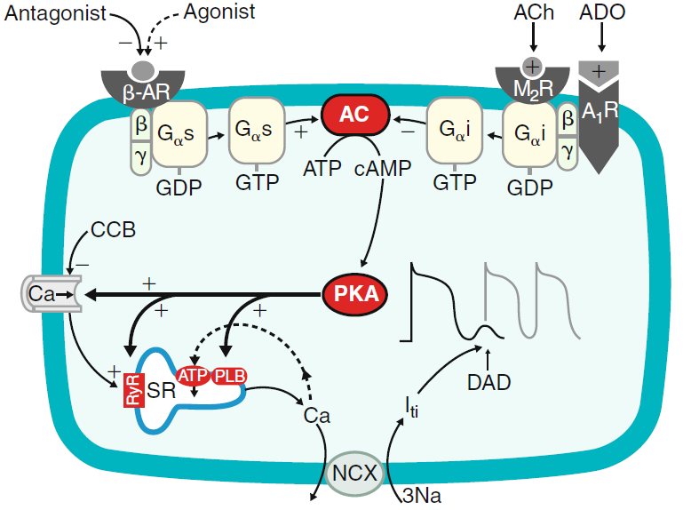
Mechanism
Triggered activity mediated by catecholamine induced delayed after depolarizations(DAD).
Increase in intracellular cyclic adenosine monophosphate (cAMP) and ICa,L
Spontaneous oscillatory release of Ca 2+ from the sarcoplasmic reticulum
Activates a transient inward current (Iti), giving rise to a DAD.

Slide 8
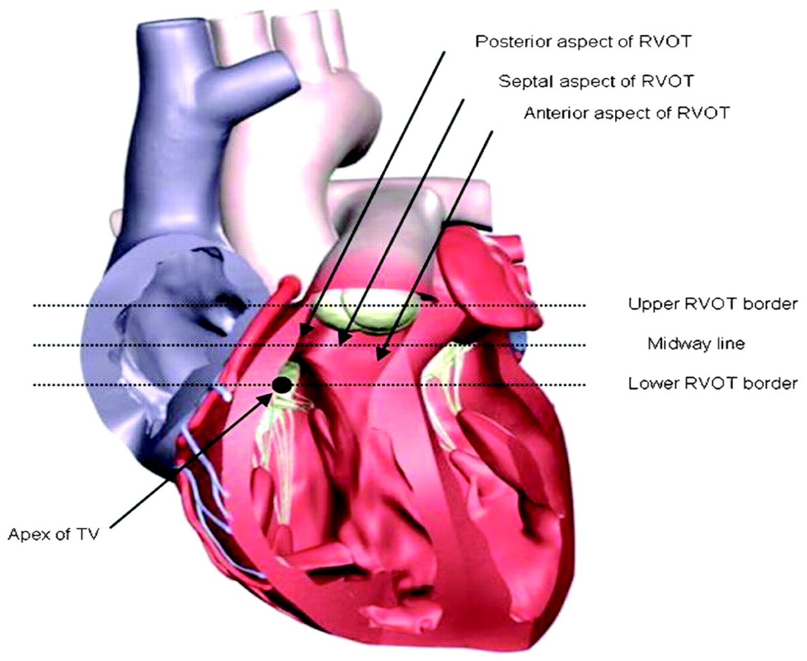
Anatomic correlates
RVOT:-
- bounded by pulmonary valve superiorly and superior aspect of tricuspid valve inferiorly.
- is a muscular infundibulum circumferentially.
- The outflow of RVOT lies to the right and anterior of LV outflow.
- The main body courses anterior to LVOT and in its superior aspect extents leftward of the LVOT.
Catheter ablation of cardiac arrythmmias, 3rd edition. Shoei K. Stephen Huang

Slide 10
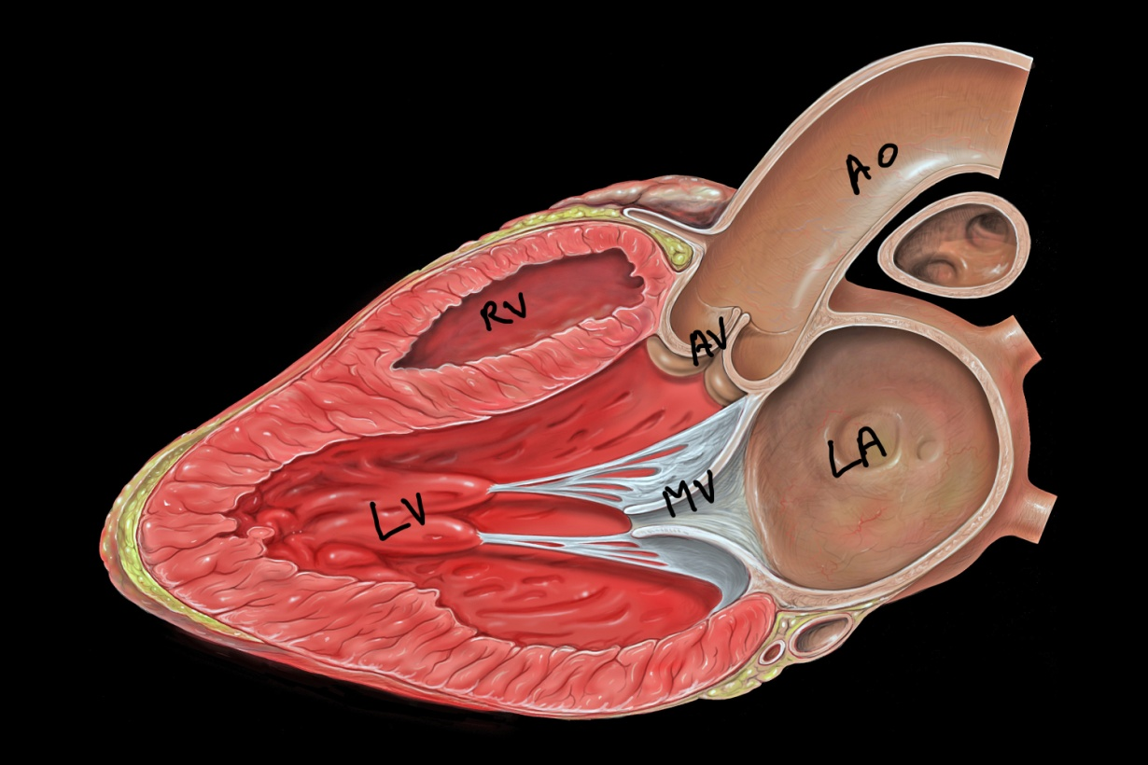
LVOT:-
- region of LV between anterior cusp of mitral valve and ventricular septum
- part muscular and partly fibrous.

Slide 11
The non- coronary cusp and posterior aspect of left coronary cusp are continuous with the fibrous aortomitral continuity.
Explains the lack of ventricular tachycardias related to the non coronary cusp.

Slide 14
RVOT VT

Slide 15
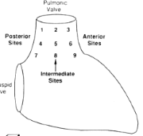
ECG in localising RVOT VT
RVOT is divided into nine distinct sites.
Sites 1 to 3 are the most superior sites below the pulmonary valve in a posterior to anterior orientation .
Vast majority of RVOT arrhtymias arise from its most superior aspect.
Jadonath : Am Heart J 1995; 130: 1107

Slide 16
Anterior vs posterior
QRS morphology in lead I is helpful in differentiating anterior vs posterior location in RVOT.
Negative QRS for tachycardia originating from anterior aspect of RVOT
Positive QRS for tacycardia originating from posterior aspect of RVOT
Site 2, typically displays either a biphasic or a multiphasic QRS pattern in lead I

Slide 17
Value of lead I in localising RVOT

Slide 18
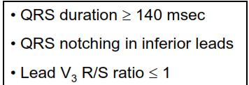
Septal Free wall
Dixit et al, JCE 2003

Slide 20
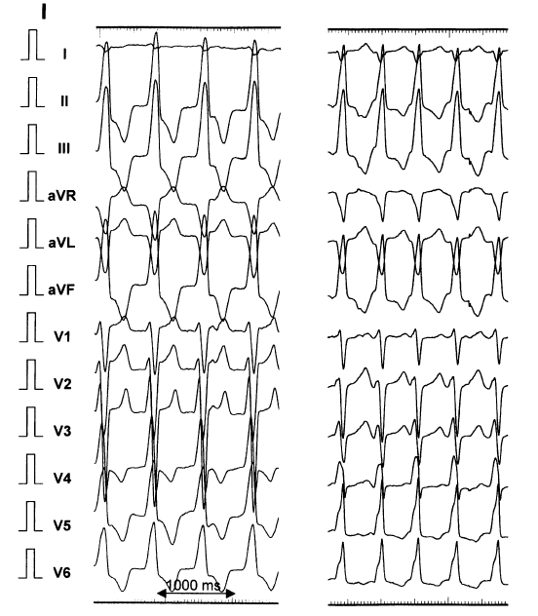
Pulmonary Artery VT
In 4-6% or RVOT vt, site of origin may be above the plane of pulmonary valve.
LBBB morphology
Greater R wave in inferior leads( location superior to RVOT)
Taller R wave in lead III compared with lead II( due to leftward orientation.
Catheter ablation of cardiac arrythmmias, 3rd edition. Shoei K. Stephen Huang.

Slide 21
D/D of RVOT
ARVD
Tachycardias associated with atriofascicular fibres. (Mahaim fibres)
Atrioventricular reentrant tachycardias using a right sided accessory pathway.
VT occuring after repair of TOF.

Slide 22
RVOT VS ARVD
Indian j med Res 131, january 2010, pp 35-45

Slide 23
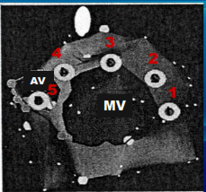
LVOT VT
Can originate from several sites.
Basal LV
-Lateral, superolateral and superior mitral annulus
-Aorto mitral continuity
-Septal parahisian region
Aortic cusp
- Left aortic cusp
- Right aortic cusp
- Non coronary cusp
Epicardial region

Slide 24
Basal LV VT

Slide 25
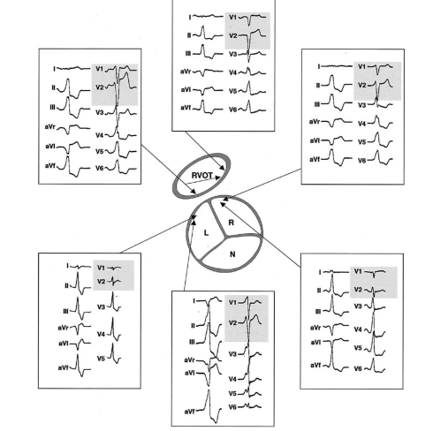
Aortic Cusp VT
Depending on the site of origin – LBBB or RBBB morphology.
Mostly arise from the left coronary cusp.
R wave duration and R/S wave amplitude ratio in leads V1 and V2 were greater in tachycardias originating from cusp compared with RVOT

Slide 27
Epicardial vt
Around 10% of patients with idiopathic VT
Perivascular origin, catecholamine enhancement and adenosine sensitivity.
Mechanism- triggered activity.
Most common site- LV summit.
LV summit- triangle formed anteriorly by the proximal LAD, laterally by the proximal LCx and superiorly by the GCV and AIV.

Slide 29
Berruezo and colleagues hypothesized that epicardial origin of ventricular tachycardia widens the initial part of QRS complex.
Pseudodelta wave :-
Interval from the earliest ventricular activation to the earliest fast deflection in the precordial leads.
Intrinsicoid deflection time (ID) :
Interval from the earliest ventricular activation to the peak of the R wave in Lead V2.
Shortest RS complex:-
Interval from the earliest ventricular activation to the nadir of first S wave in any precordial lead.

Slide 31
Precordial maximum deflection index
Beginning of QRS to earliest maximal deflection in any precordial leads / QRS duration. (> 0.55) (sensitivity of 100%, specificity of 98%)
Shortest precordial complex:
Interval from earliest ventricular activation to the 1st S wave in any precordial lead. (> 121 ms)
Daniels and colleagues

Slide 32
Clinical features
Equal distribution between men and women.
RVOT VT are more common in females where as VTs originating in aortic cusps are more common in men.
Mean age at diagnosis- 50± 15 years.
Most common symptom- palpitations.
Other symptoms- Fatigue, low energy, light headedness, rarely syncope.
Catheter ablation of cardiac arrythmmias, 3rd edition. Shoei K. Stephen Huang.

Slide 33
Provoked by physical or emotional stress, anxiety and stimulants such as caffeine.
Females - premenstrual and perimenopausal periods and with gestation suggesting hormonal influence.
Typically benign course.
Small percentage may develop a reversible form of cardiomyopathy.
Catheter ablation of cardiac arrythmmias, 3rd edition. Shoei K. Stephen Huang.

Slide 34
Treatment
May respond acutely to carotid sinus massage, Valsalva maneuvers or intravenous adenosine or verapamil
Long-term oral therapy with either BB or CCB
Nonresponders (33%)- class I or III antiarrhythmic agents

Slide 35
RFA
When medical therapy is ineffective or not tolerated
High success rate (>80%)
Ablation of epicardial or aortic sinuses of Valsalva sites is highly effective
Technically challenging and carries higher risks -proximity to coronary arteries

Slide 36
Complications during outflow tract VT ablation are rare
RBBB (1%)
Cardiac perforation
Damage to the coronary artery (LAD) - cusp region ablation
Overall recurrence rate is approximately 10%

Slide 37
Fascicular VT
First recognized by Zipes and colleagues.
Diagnostic triad:-
- induction with atrial pacing.
- RBBB and left axis configuration
- Absence of structural heart disease.
Belhassen and associates, fist demonstrated the verapamil sensitivity of tachycardia.
Ohe and colleagues, reported another type of this tachycardia with RBBB and right axis deviation.

Slide 38
Idiopathic left VT
Three varieties
left posterior fascicular VT -RBBB and LAD (90%)
left anterior fascicular VT -RBBB and RAD
high septal fascicular VT -relatively narrow QRS and normal axis

Slide 39
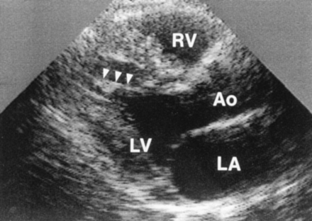
Anatomic substrate
May originate from a false tendon or fibromuscular band in the LV.
Thakur and colleagues,
- 15 of 15 patients with idiopathic left VT but in only 5 % of control patients.
Lin and colleagues:-
-17 of 18 patients with idiopathic VT
- 35 of 40 controls

Slide 40
Electrophysiologic mechanism
Mechanism – Reentry
Antegrade limb- Specialised verapamil sensitive zone from basal to apical site of left ventricular septum.
Retrograde limb- posterior fascicle from apical to basal septum.
Zone of slow conduction- completes the circuit.

Slide 41
Purkinje potentials
Represents the activation of left posterior fascicle or purkinje fibre near left posterior fascicle.
Brief, sharp, high frequency potential preceding the onset of QRS complex during tachycardia.
Relative activation time of PP to onset of QRS complex is 5-25 ms.

Slide 42
Pre purkinje potential
Represents exciation at the entrance to the specialized zone in the ventriular septum.
Dull, lower frequency potential preceding Purkinje potential during tachycardia.
Relative activation time of pre-pp to onset of QRS complex is 30-70ms.

Slide 43
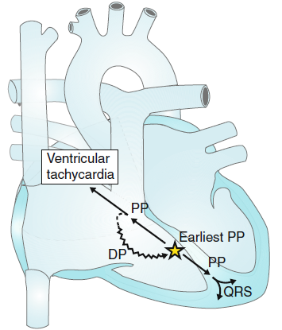
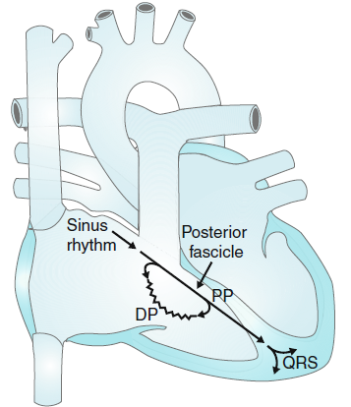
Area is captured antidromically during tachycardia and at higher pacing rates-pre-PP precedes PP during tachycardia.
Captured orthodromically in sinus rhythm and at relatively lower pacing rates- pre PP follows ventricular complex
Nakagawa and colleagues

Slide 44
15 to 40 years
More in men (60%)
Most occur at rest
Usually paroxysmal
Incessant forms leading to TCM are described

Slide 45
Long-term prognosis is very good
Patients who have incessant tachycardia may develop a tachycardia related cardiomyopathy
Intravenous verapamil is effective in acutely terminating VT
Mild to moderate symptoms oral –verapamil
BB and class I and III antiarrhythmic agents useful
Medical therapy is often ineffective in patients who have severe symptoms

Slide 46
RFA
Fascicular tachycardia associated with presyncope or syncope.
With recurrent sustained tachycardia.
Intolerant or resistant to medical therapy.
Results are excellent with success rates of approximately 90 %.

Slide 47
Genetic syndromes
Long QT
Brugada Syndrome
CPVT
Short QT

Slide 48
Long QT syndrome
LQTS is an IAD characterized by abnormally prolonged QT interval.
Thirteen different genes described
LQT1, LQT2, and LQT3 account for 75%
LQT1 and LQT2 -mutations of KCNQ1 and KCNH2 genes that encode subunits of IKs and Ikr potassium channels.
LQT3 -mutations of SCN5A gene that encode subunits of INa sodium channels
Approximately 25% don’t have identifiable gene mutations

Slide 49
CHANNELOPATHY | GENE | PROTEIN
LQT 1 | KCNQ1 | α-subunit of Iks
LQT 2 | KCNH2 | α-subunit of Ikr
LQT 3 | SCN5A | Sodium channel, α-subunit
LQT 4 | ANK2 | Cellular structural protein
LQT 5 | KCNE1 | β-subunit of Iks
LQT 6 | KCNE2 | β-subunit of Ikr
LQT 7 | KCNJ2 | α-subunit of Ik1

Slide 50
CHANNELOPATHY | GENE | PROTEIN
LQT 8 | CACNA1C | l-type Ca + channel, α-subunit
LQT 9 | CAV3 | Plasma membrane structural protein
LQT 10 | SCN4B | Sodium channel, β-subunit
LQT 11 | AKAP9 | Kinase anchoring protein (Yotaio)
LQT 12 | SNTA1 | Syntrophin α1 (affects sodium current)
LQT 13 | KCNJ5 | Inwardly rectifying potassium channel, α-subunit

Slide 51
Molecular basis for long QT syndrome
Topol EJ, Califf RM et al

Slide 52
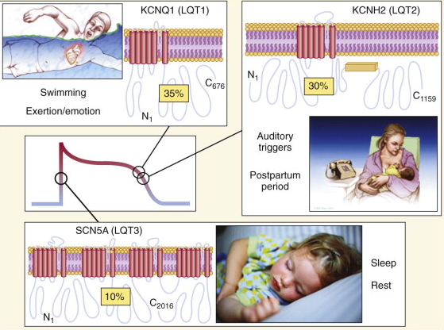
Triggers of arrhythmia
Swimming and exertion-induced cardiac events are strongly associated with LQT1.
Auditory triggers and events
during postpartum period
occur in pts with LQT2.
Events occurring during periods of sleep or rest are most common in LQT3.

Slide 53
Occurrence of Gene-Specific Triggers
Percent
Circ 2001;103:89-95
Notes:
This study identified patients of a known genotype, who had experienced significant cardiac events. Triggers for cardiac events according to 3 genotypes: percentage of patients in each genotype, and the pattern of triggers within each genotype.
(Schwartz, et al. Circulation. 2001;103:89-95).
In the LQT1 variant, exercise is a trigger for >60%, while barely 3% are triggered while at rest.
In the LQT2 variant, a significant number of events occur due to emotional stress or while at rest, while exercise is a trigger in only 13%.
In LQT3, the majority of events appear to occur during sleep or at rest.
LQT1 is the only variant that has a high percentage of events occurring during exercise, and thus is very different from LQT2 or LQT3. LQT1 patients would be advised not to participate in competitive athletic activities.

Slide 54
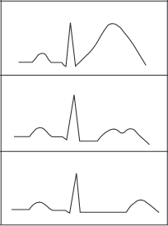
ECG in LQTS
QTc values exceeding 450 ms (in males) and 460 ms (in females) are considered abnormal .
LQT1 is associated with a broad-based T wave.
LQT2 with low-amplitude notched or
biphasic T wave.
LQT3 with long isoelectric segment followed by a narrow-based T wave.

Slide 55
LQTS : Diagnostic Criteria
Score
≤1 point: low probability
1.5–3 points: intermediate probability
≥3.5 points: high probability.
Schwartz et al
Circ Arrhythm Electrophysiol. 2012;

Slide 56
Jervell and Lange-Nielsen syndrome
Autosomal recessive variant of long QT syndrome.
Due to homozygous or compound heterozygous mutations on either the KCNQ1 or KCNE1 genes.
Pts also suffer from congenital deafness.
Most severe of major variants of LQTS.
90% have cardiac events, 50% become symptomatic by
age of 3 yrs and their average QTc is markedly prolonged (557± 65 ms)

Slide 57
Management
- Avoid trigger events and medications prolong QT interval
- Risk stratification schemes based on degree of QT prolongation, genotype, and sex
- Corrected QT interval exceeding 500 ms poses a high risk for cardiac events
- Patients who have LQT2 and LQT3 may be at higher risk for SCD compared with patients who have LQT1

Slide 58
Risk stratification
Risk of a 1st cardiac event in pts younger than 40 years of age in the absence of any LQTS active treatment

Slide 59
Beta blockers
BB are indicated for all patients with syncope and for asymptomatic patients with significant QT prolongation
Role of BB in asymptomatic patients with normal or mildly prolonged QT intervals remains uncertain.
BB are highly effective in LQT1, but less effective in other LQTS
Role of BBs in LQT3 is not established.
Because LQT3 is a minority of all LQTS, symptomatic patients who have not undergone genotyping should receive BBs

Slide 60
ICD are indicated for secondary prevention of cardiac arrest and for patients with recurrent syncope despite BB therapy
Less defined therapies
- Gene-specific therapy with mexiletine , flecainide , or ranolazine for some LQT3 patients
- PPI for bradycardia-dependent torsade de pointes
- Surgical left cardiac sympathetic denervation for recurrent arrhythmias resistant to BB therapy

Slide 62
Brugada syndrome
Characterized by coving ST-segment elevation in V1 to V3
2 mm in 2 of these 3 leads are diagnostic
Complete or incomplete RBBB pattern
Pattern can be spontaneously present or provoked by sodium-channel blocking agents such as ajmaline, flecainide, or procainamide
- Typical ECG pattern can be transient and may only be detected during long-term ECG monitoring.

Slide 63
Genes Involved in Brugada
CHANNELOPATHY | GENE | CHANNEL/PROTEIN | Effect
BrS 1 | SCN5A | Cardiac sodium channel α subunit | ↓ Na⁺ current
BrS 2 | GPD1L | Glycerol-6-phosphate dehydrogenase | ↓ Na⁺ current
BrS 3 | CACNA1C | L-type calcium channel α subunit | ↓ Ca²⁺ current
BrS 4 | CACNB2 | L-type calcium channel β subunit | ↓ Ca²⁺ current
BrS 5 | SCN1B | Cardiac sodium channel β₁ subunit | ↓ Na⁺ current
BrS 6 | KCNE3 | Transient outward current β subunit | ↑ K⁺ Ito current
BrS 7 | SCN3B | Cardiac sodium channel β₃ subunit | ↓ Na⁺ current

Slide 64
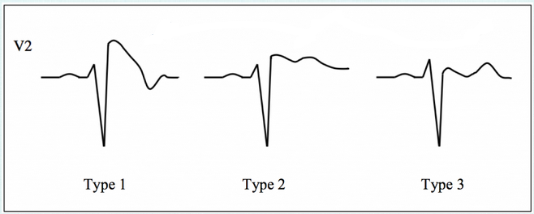
ECG patterns
Type-1
≥ 2-mm J-point elevation, coved type ST-T segment elevation and inverted T-wave in leads V1 and V2.
Type-2
≥ 2-mm J-point elevation, ≥ 1-mm St segment elevation, saddleback ST-T segment and a positive or biphasic T-wave.
Type-3
Same as type 2, except that the ST-segment elevation is <1 mm.

Slide 65
Placement of precordial
leads in higher intercostal spaces can unmask the
Brugada ECG pattern

Slide 66
Clinical presentation
Syncope or cardiac arrest
Predominantly in men in third and fourth decade
Also been linked to SCD in young men in Southeast Asia and has several local names,including Lai Tai (“died during sleep”) in Thailand
- Prone to atrial fibrillation and sinus node dysfunction

Slide 67
Brugada : Diagnostic criteria
Appearance of type 1 ST segment elevation (coved type) in > 1 rt precordial lead (V1 - V3) in the presence or absence of a sodium channel blocker, plus at least one of the following:
Documented ventricular fibrillation.
Polymorphic ventricular tachycardia (VT).
Family h/o sudden cardiac death at less than 45 years of age.
Family h/o of type 1 Brugada pattern ECG changes.
Inducible VT during electrophysiology study.
Unexplained syncope.
Nocturnal agonal respiration .
Type 2 and type 3 ECG are not diagnostic of Brugada syndrome
Second Consensus Conference : Europeon Heart Rhythm Society

Slide 68
Brugada pattern : Pts with typical ECG features who are asymptomatic and not having other clinical criteria.
Brugada syndrome : Pts with typical ECG features and clinical criteria (who have experienced sudden cardiac arrest or a sustained ventricular tachyarrhythmia or who have one or more of the other associated clinical criteria )

Slide 69
Drug challenge
In pts with resting ECG type 2 or 3 Brugada pattern and having family h/o sudden cardiac death at < 45 yrs and/or a family h/o type 1 Brugada pattern ECG
Drugs used
Flecainide : 2 mg/kg over 10 min iv or 400 mg PO
Procainamide : 10 mg/kg over 10 min iv
Ajmaline : 1 mg/kg over five minutes iv
Pilsicainide : 1 mg/kg over 10 minutes iv

Slide 70
Drug challenge
Indications for termination of the drug challenge include:
Development of a diagnostic type 1 Brugada pattern
≥2 mm increase in ST segment elevation in pts with type 2 Brugada ECG pattern
Development of ventricular premature beats or other arrhythmias
Widening of the QRS ≥30 percent above baseline

Slide 71
Management

Slide 72
Catecholaminergic PMVT.
Disorder of myocardial calcium homeostasis
Clinically manifested as exertional syncope and SCD due to exercise induced VT
Often polymorphic or bidirectional

Slide 73
Genetic basis
Mutations in 2 genes are identified : ryanodine receptor gene (RyR2) and calsequestrin 2 gene (CASQ2).
RyR2 mediates release of Ca+ from SR which is is required for myocardial contraction.
RyR2 mutation result in Autosomal Dominant form of CPVT
Calsequestrin 2 protein is a protein in sarcoplasmic reticulum which binds large amounts of calcium.
CASQ2 mutation result in Autosomal Recessive form of CPVT.

Slide 74
Mechanism for Arrhythmogenesis
Delayed after depolarization (DAD) dependent triggered activity.
Mutant ryanodine receptor is leaky and it releases excess of calcium during diastole.
This activates sodium-calcium exchanger that extrudes calcium ions out from the cell.
This generates a net inward current results in DAD.
When large enough, DADs trigger extrasystolic action potential.

Slide 75
Mechanism for Arrhythmogenesis

Slide 76
Management

Slide 77
Short QT Syndrome
Rare condition with short-QT interval (<320 ms).
Presents symptomatically with recurrent syncope, sudden cardiac death and atrial fibrillation.
Mutations in 6 different genes (3 gain of function and 3 loss of function) are identified .

Slide 78
Genes in SQTS
CHANNELOPATHY | GENE | CHANNEL /PROTEIN
SQT 1 | KCNH2 | I_{Kr}
SQT 2 | KCNQ1 | I_{Ks}
SQT3 | KCNJ2 | I_{K1}
SQT4 | CACNA1C | l-type ca+ channel, α-subunit
SQT5 | CACNB2 | l-type ca+ channel, β-subunit
SQT 6 | CACNA2D1 | l-type calcium channel subunit

Slide 79
Proposed Diagnostic Criteria: SQTS
Michael H. Gollob, MD, Calum J. Redpath et al JACC Vol. 57, No. 7, 2011

Slide 81
Idiopathic VF
Presents as syncope or sudden cardiac death in young people with structurally normal heart.
Defined as a resusucitated cardiac arrest victim, preferably with documentation of VF in whom known cardiac, respiratory, metabolic and toxicological etiologies have been excluded.
No identifiable genetic syndromes.
Unrelated to stress or activity.
May occur in clusters characterised by frequent ventricular ectopy and short episodes of VF.
Triggered by PVCs, generally with a short coupling interval.

Slide 82
Idiopathic VF
Early repolarisation pattern in the inferior or lateral ECG leads occurs more frequently in patients with IVF than in normal subjects.
Isoproterenol- useful in suppressing VF in acute setting.
Quinidine – useful in chronic cases.
ICD- recommended for patients with IVF.

Slide 83
THANK YOU

